Slide 1

Exercise 4.3 P-241
Where P is permutation
matrix and a_{ij} are elements
of matrix. A=[a₁₁ a₁₂ a₁₃
a₂₁ a₂₂ a₂₃
a₃₁ a₃₂ a₃₃ ]
The terms appears in big formula like this a₁₁ a₂₂ a₃₃+ a₁₂ a₂₃ a₃₁ + a₁₃ a₂₁ a₃₂ - a₁₁ a₂₃ a₃₁
a₁₂ a₂₁ a₃₁ - a₁₃ a₂₂ a_{31.}

Slide 2
Observe that there is +ve sign in the first three terms of the big formula because there is cyclic order at the second position of elements whereas there is –ve sign in the other three term because there is anti cyclic order in the second position of elements. Remember that there is always 1 to 3 in the first position of elements. Just +ve for cyclic order and –ve for anti-cyclic order.

Slide 3
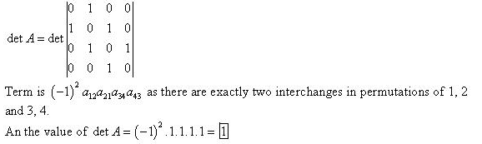
Problem 1
By keeping in mind the big formula at page 1 and its application procedure at page 2,
som
We have not written the terms where it is zero at the position of elements.

Slide 4

Determinant in terms of Cofactor
Where A₁₁ is the cofactor of a₁₁ and so on and this is computed by deleting first row and first column multiplied with (-1) ¹⁺¹ because it is present in first row and first column. If we do not multiplied with this term that is (-1) ¹⁺¹ then it is known as minor.

Slide 5
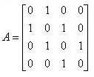

You have read about the minor and cofactor in Fsc and solve all the related problems by yourself and if you face any difficulty then let me know. If then

Slide 6
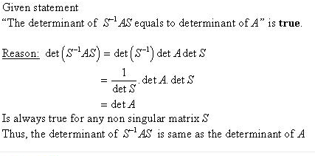
Problem 3
You must remember 10 properties determinant in very good way.

Slide 7
Problems 13 to 17 are related to big formula and solve them by using problem 1 and the information given on page 2
Find the solution of 24 and 25 problem by cofactor method as I told about cofactor earlier.

Slide 8
Block Matrix: A matrix whose entires are itself matrix are known as block matrix. I have taught you about block matrix before midterm. Use that concept to dealt with the determinant of block matrices. If you face any difficulty then please let me know.

